Slide 1
Acoustic event recognition System
Progress Report
Group 11 (Naveen gupta, Aryan garg, Akash Sharma, Kush Sharma

Slide 2
Introduction
Acoustic event Recognition is field of autonomously recognizing different events based on sound.
Sound detect through the features which are extracted from .wav format audio.
Features like mfcc , chroma_stft , zero crossing etc.
Sounds like beach, car, restaurant, train, bus, cafe etc.

Slide 3
Application
SONAR : It can be used for the purpose of Defense System like in the detection of submarines.
Recognition of Language : Automatic speech recognition for specific languages and contexts.
Surveillance : Detecting dangerous events and crimes form audio.
Monitoring : Recognition of noise sources, machine faults

Slide 4
Collection and Evaluation of Dataset
Source - https://zenodo.org/record/400515#.X4mkamgzZPZ
Data type- Audio type (.wav format)
Size- 1.0 GB

Slide 5

Sample of Dataset

Slide 6
Evaluation of Dataset
Total Number of Audio files:- 458
Total Number of Classes:- 14
Duration of each audio file:- 10 sec
Name of the classes:- Beach, Bus, Café, Car, City_centre
Forest_path, Grocery_store, Home, Libarary, Metro_station, Office, Park, Residential_area, Train

Slide 7

Image of Final Dataset (Arranged)

Slide 8
Feature Extraction
Transformation of input data into set of features.
Features are distinctive properties of input patterns.
Help in differentiating between categories of input patterns.
Number of feature extracted : 26
Features are :
chroma_stft , rmse, spectral_centroid, spectral bandwidth, roll off , zero_crossing_rate ,
mfcc(1-20).

Slide 9
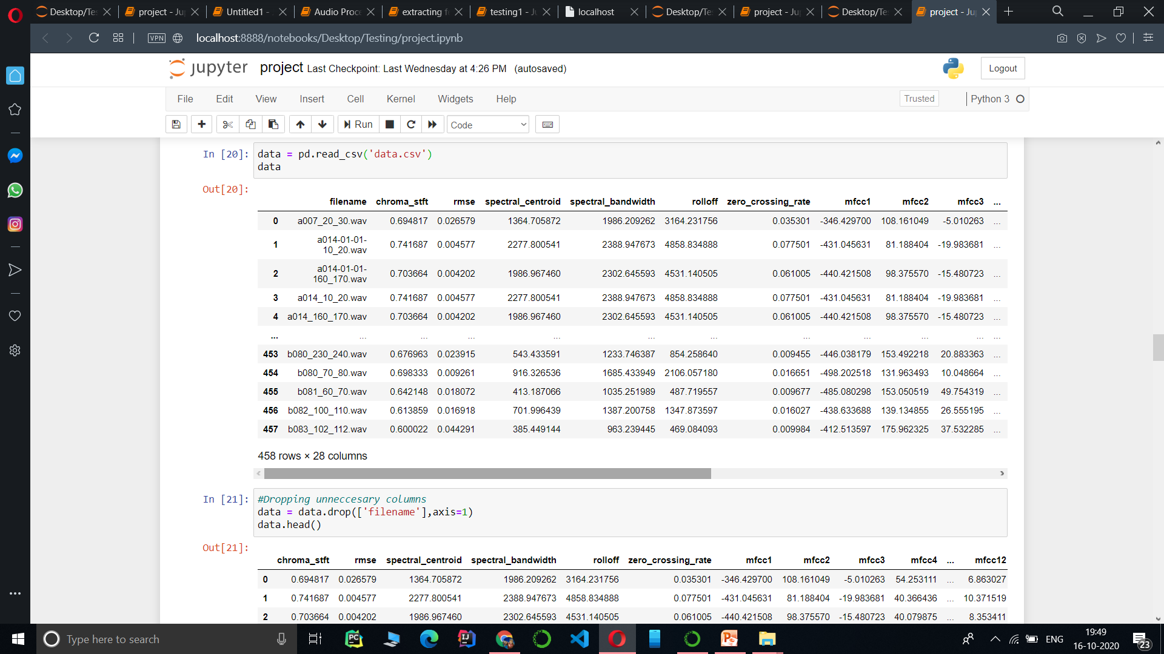
Feature Extraction

Slide 10
Decision Tree Algorithm
It is supervised learning algorithm.
It is used for classification as well as regression.
It is a tree-structured classifier, where internal nodes represent the features of a dataset, branches represent the decision rules and each leaf node represents the outcome.
In a Decision tree, there are two nodes, which are the Decision Node and Leaf Node.
Decision nodes are used to make any decision and have multiple branches, whereas Leaf nodes are the output of those decisions and do not contain any further branches.
In order to build a tree, we use the CART algorithm, which stands for Classification and Regression Tree algorithm

Slide 11

Decision tree

Slide 12
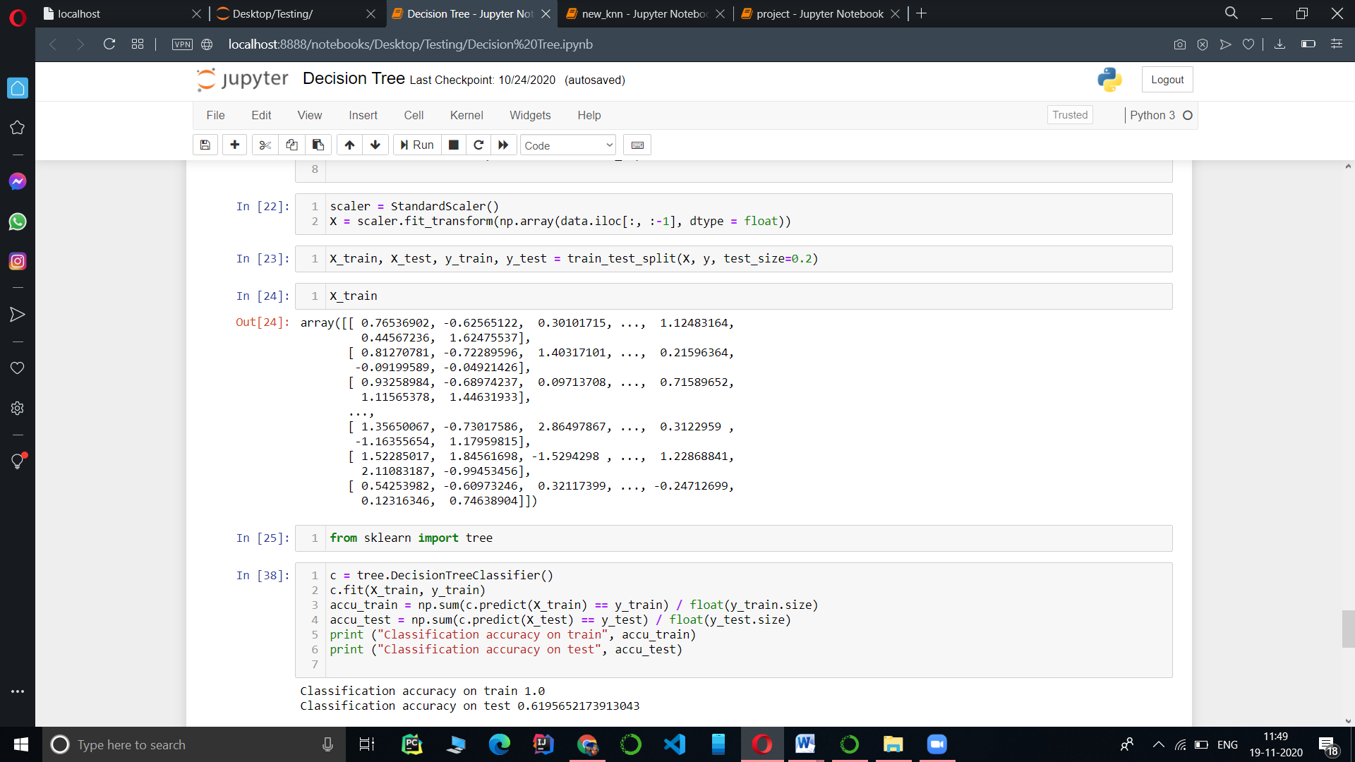
Accuracy- 61%

Slide 13
KNN Algorithm
KNN is a supervised learning algorithm.
Used for both classification as well as regression.
It is lazy-learning algorithm.
It is Non-parametric learning algorithm.
It uses feature similarity to predict the values of new data points.
New data points will be assigned the value based on how closely it matches the points in the training set.

Slide 14
Classification Model- KNN
Accuracy for k=3 :- 77%
Accuracy for k=5 :- 72%
Accuracy for k=7 :- 68%
Accuracy for k=13 :- 61%

Slide 15
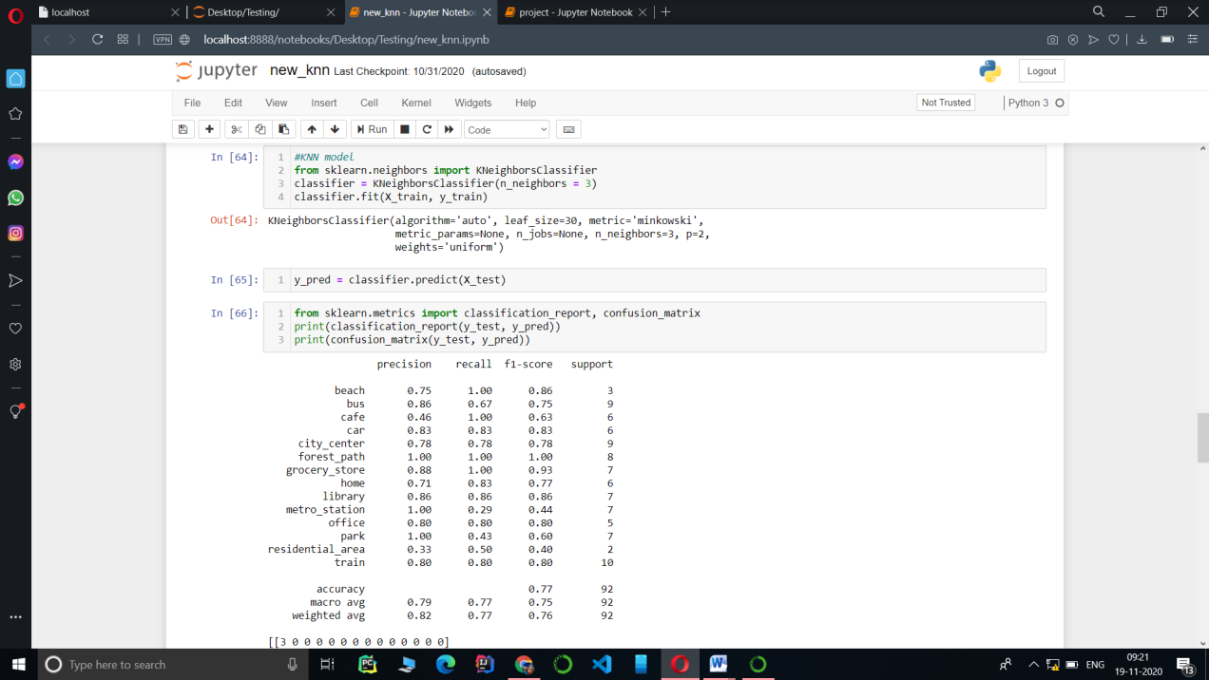
Accuracy for k=3

Slide 16
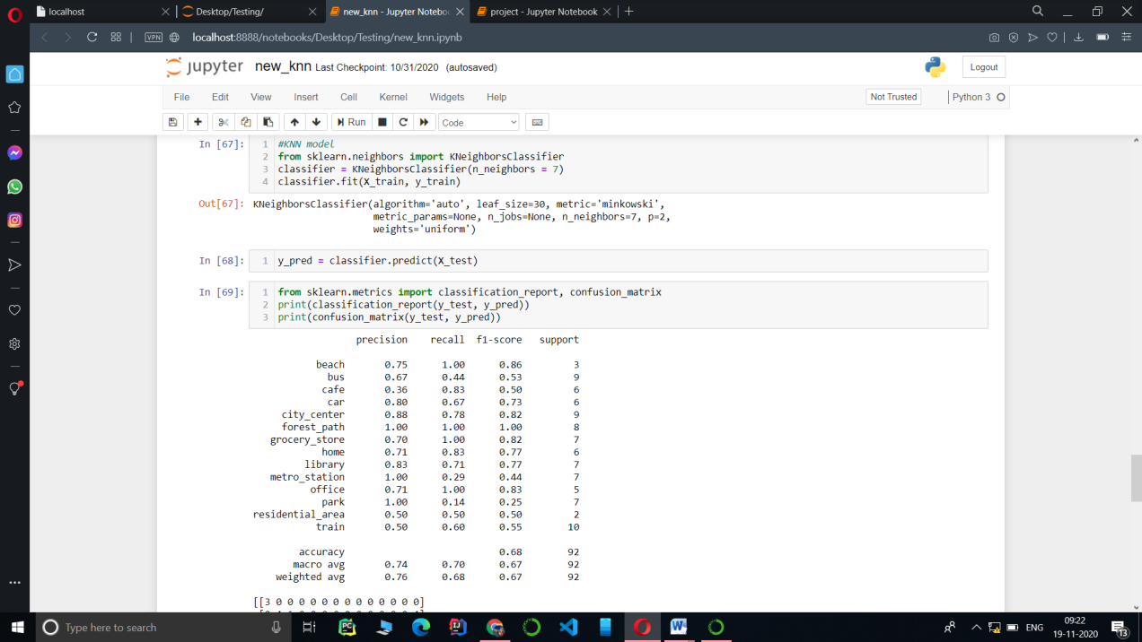
Accuracy for k=7

Slide 17
Logistic Regression
It is supervised learning Technique.
Type of classification Algorithm.
Based on linear regression to evaluate output and to minimize the error.
Used to predict the probability of target variable.
Dependable variable is binary in nature having data coded as either class 1 or class 0.
Predict by sigmoid function.
h_{θ}(x) = g((θ^{T} x))
g(z) = 1/(1 + e^{-z})
Y=1 if h_{θ}(x)>=0.5 – class 1
Y=0 if h_{θ}(x) <0.5 – class 0

Slide 18
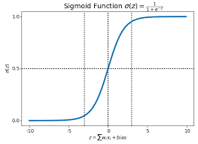
Sigmoid function

Slide 19
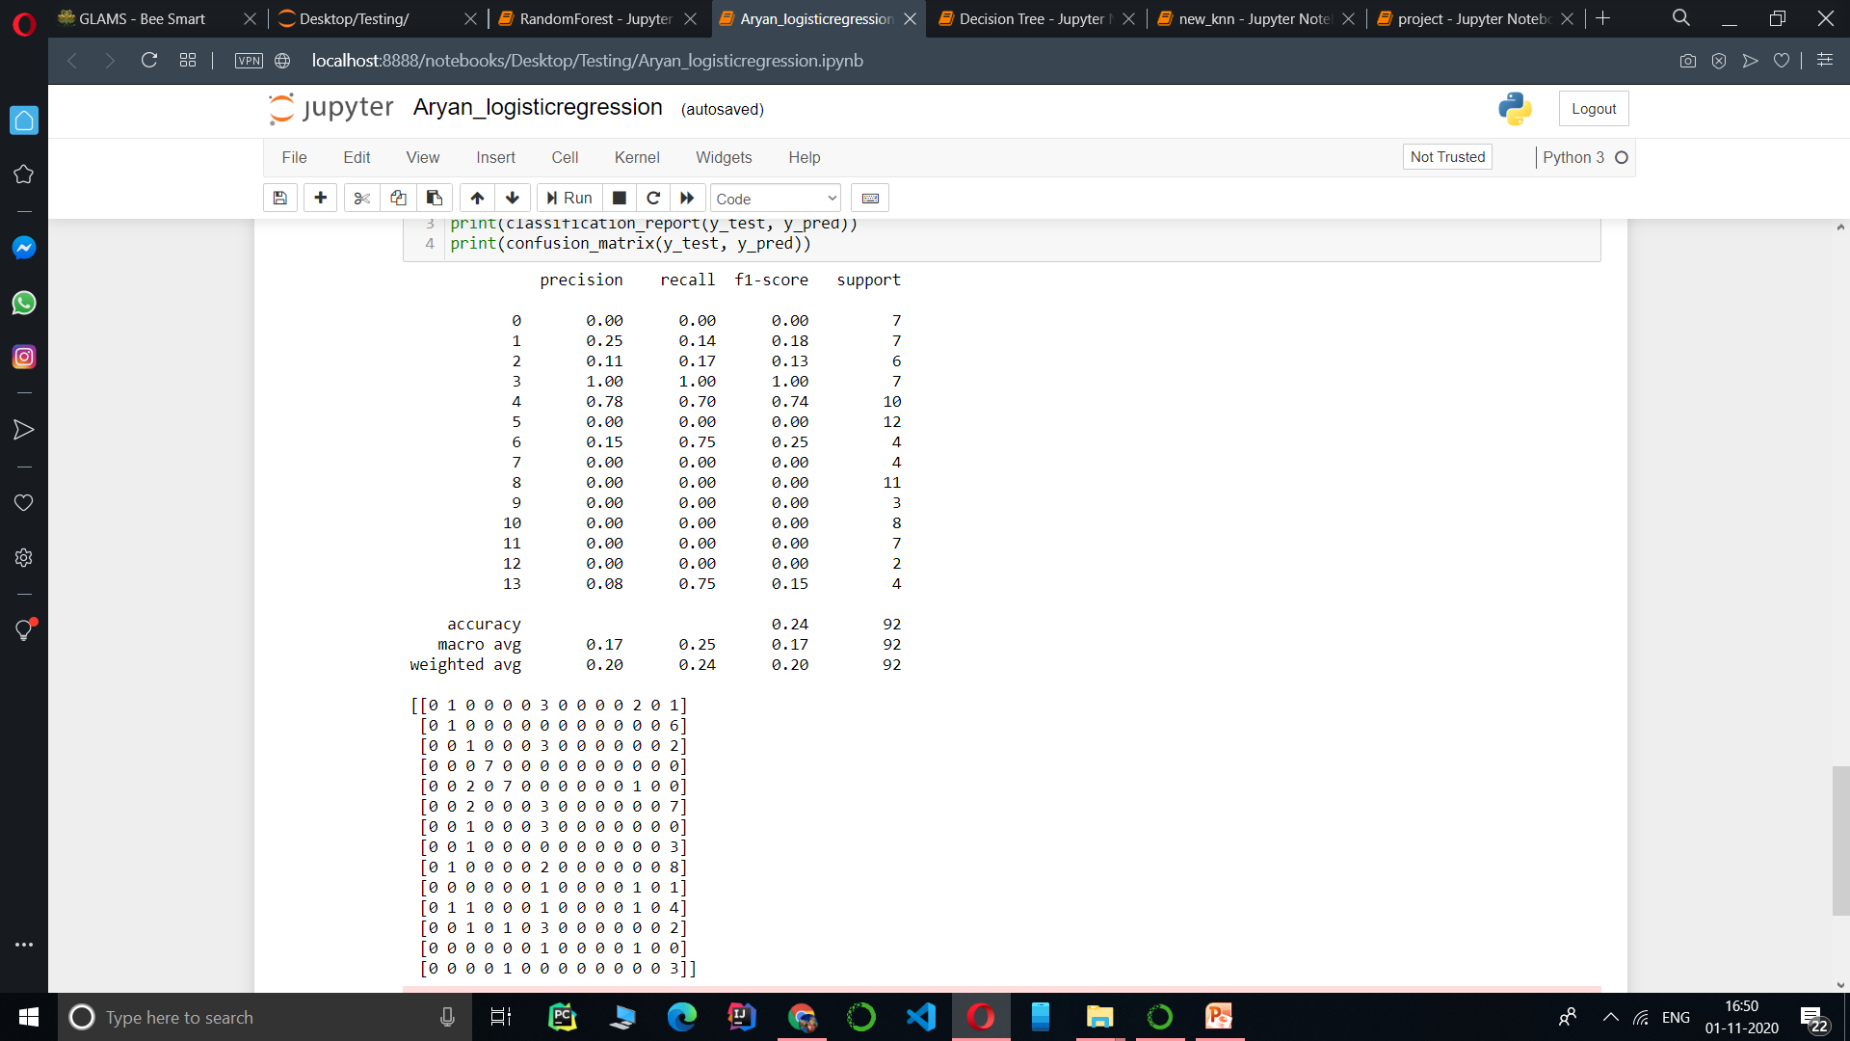
Accuracy -24%

Slide 20
Random forest
It is supervised learning algorithm .
Used for both classification as well as regression.
It is ensemble based learning method.
As we know forest is made up of trees more trees means more robust forest.
Similarly, random forest algorithm creates decision trees on data samples.
Prediction from each of the them and finally select the best solution by means of majority voting.
Better from single decision prediction because it reduces the overfitting by average the result.

Slide 21
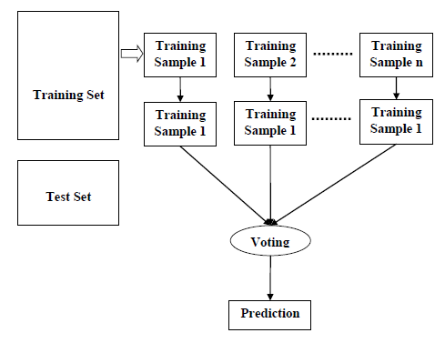
working

Slide 22
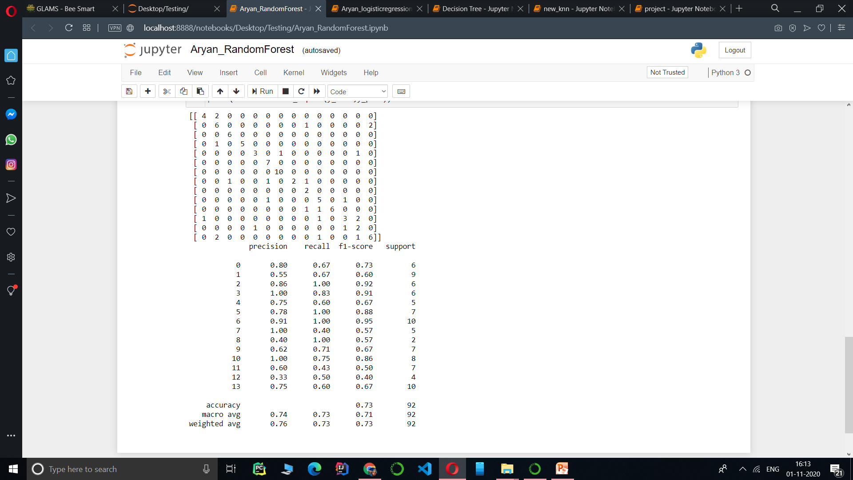
Accuracy- 73%

Slide 23
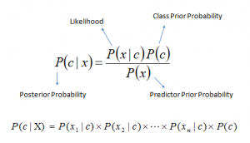
Naive Bayes classifier
It is classification technique based on Bayes Theorem.
It assumes that the presence of a particular feature in a class unrelated to presence of any other feature.
it is easy to build and particularly useful for very large data sets.
Bayes theorem provides a way of calculating posterior probability P(c|x) from P(c), P(x) and P(x|c).

Slide 24
Probabilities
P(c|x) is the posterior probability of class (c, target) given predictor (x, attributes).
P(c) is the prior probability of class.
P(x|c) is the likelihood which is the probability of predictor given class.
P(x) is the prior probability of predictor.

Slide 25
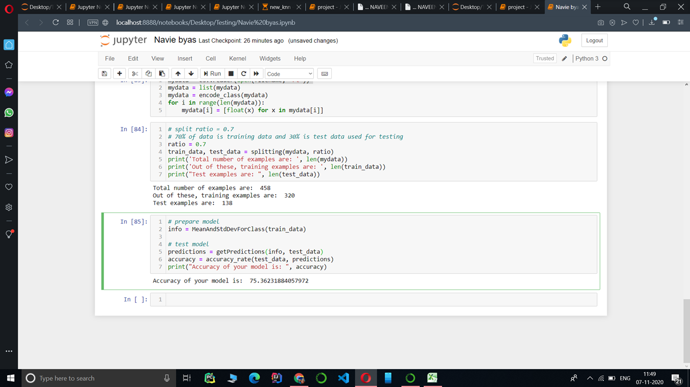
Accuracy-75%

Slide 26
Conclusion
Name Accuracy
1 Naive Bayes 68
2 KNN (k=1) 80
3 KNN (k=3) 77
4 KNN (k=5) 72
5 KNN (k=7) 68
6 Random Forest 73
7 Decision Tree 61
8 Logistic Regression 24

Slide 27
THANK YOU

